Slide 1
Livestock
Dairy
Fishery

Slide 2
Livestock
India accounts for about 17% of the cattle population
64% of the buffalo population
Rate of increase in milk production = 4.2% which is higher than the growth rate of population (1.2% -2013).
Per capita availability of milk is 281gm per day (2013-14) > 186gm/Day (Asia)
294gm/Day (world average)

Slide 3
Dairy Development: Amul
Farmers of kheda district with help of Sardar Patel and Morarji Desai organised a cooperative union.
It registered as kheda district cooperative milk producers’ union ltd. in 1946
Tribhuvandas Patel persuaded farmers door to door to join the milk cooperative
Dr. vergese Kurien who led white revolution, led the cooperative between 1950 to 1973

Slide 4
Success of Amul
Amul was first dairy to produce cheese and baby food from buffalo milk
Amul provides artificial insemination, veterinary facilities, insurance cover and quality green fodder to the farmers of the union
IRMA was founded in Anand for professional managers for rural development projects
In 1974, Gujarat cooperative milk marketing federation ltd. – apex organization of the union to look after marketing

Slide 5
National Dairy Development Board
In 1964, Lal Bahadur Shashtri initiated all states to set up cooperative dairies based on Anand pattern
In 1965 he created NDDB with kurien as his chairman and HQ at Anand

Slide 6
Operation Flood
NDDB launched operation flood launched in 1970 to replicate Anand pattern in other part of the country
The operation made India – world’s largest milk producer, surpassing USA in 1998
Today India’s milk output is 17% of world’s output

Slide 7
Phase I: Operation flood
Mother dairies : in 4 metro cities
Production- collection and marketing from rural hinterlands of metro cities

Slide 8
Phase II: Operation flood
Increase sheds and outlets
Thousands of milk cooperatives and milk producers covered
“RAKSHA” vaccine developed for cattle health

Slide 9
Phase III: Operation flood
Increase infrastructure for procurement
R&D animal health and nutrition – for enhanced productivity for milch animals
Feed, veterinary service, artificial insemination service
Dairy education for members of union

Slide 10
Outcome of Operation flood
It increased milk supply and income of the farmers, mainly small and landless farmers
women empowerment – Operation flood take assistance from SEWA and established 6000 women dairy cooperative societies
To NDDB has indigenous expertise in animal health, animal nutrition, artificial insemination, Management Information System (MIS), dairy engineering and food technology

Slide 11
Success of Cooperatives
Cooperative farming
Cooperative dairy
Land size
Fertility of land
Investment
Knowledge-expertise
Hard-work
Agro-tools
Individual farmer submit the milk container
Gets money according to weight and quality of milk
Bonus or share from the profit to cooperative members

Slide 12
National Livestock Mission
Introduced in FY 2014-15
Dept. of Animal husbandry and dairying, Ministry of Agriculture
Fodder and feed development -> to meet scarcity of animal feed resource

Slide 13
Fodder development
Feed Security Bill on the lines of Food Security Bill.
To decide the milk pricing policy
Milk Credit Card at minimum rate of interest
Setting up Gobar Bank (fertilizer+ biogas)
Collection centres for urine of cow so that it becomes an additional source of income for farmers.
Marketing facility for cow products

Slide 14
Veterinary health: issues
Need for universal vaccination of cattle on regular basis
Improve the condition of semen banks
Issue of shortage of veterinary doctors, veterinary colleges and universities. - absence of govt. grant to veterinary institutes

Slide 15
Indigenous cattle
Indigenous cattle breed are vulnerable to extinction
India, total 83% of cow population is indigenous
But there is decline in indigenous cattle population by 8% in 2007
There are 37 recognised indigenous cattle breed in India
Examples- Gir, rathi, Sahiwal, Kasaragod, Kankrej, Amrithmahal

Slide 16
Challenges: indigenous cattle breed
Excessive cross-breeding
farm-mechanisation – utility of drought breeds decreased
Decline of grazing grounds
Fragmentation of agricultural landholdings
shift to cash crops such as rubber

Slide 17
Importance of Indigenous cattle breed
Indigenous cattle breeds are better than exotic cattle breed
reasons:
They are adapted to arid weather conditions, -crossbred cattle require regular supply of fodder.
lower feed intake
disease resistance
easier management
suitable for drought work

Slide 18
Indigenous cattle
the average milk yield is lower than hybrid but their quality of the milk is very rich
They produce quality compost manure for areca nut, rice and coconut farms.
They can be fed on kitchen leftovers, straw, local grass and agricultural by-products
Existing superior indigenous breed can provide research input to develop better breed on the future

Slide 19
To conserve Indigenous cattle breed
Rashtriya Kamdhenu Breeding centre
Rashtriya Gokul Mission

Slide 20
Rashtriya Kamdhenu Breeding centre
2 kamdhenu breeding centres- one each in Northern India and southern India
There will be Nucleus herds of all indigenous breeds
They will be repositories of indigenous germ-plasm and source of certified genetics in the country
Certified germ-plasm will be made available to farmers, breeding institutes and trust maintaining indigenous breeds

Slide 21
Rashtriya Gokul Mission
It is a project under National Programme for Bovine Breeding and Dairy Development (BBDD)
37 indigenous breeds of cattle and 13 buffalo breeds
It aims to conserve Indigenous Breeds in a scientific manner.
Develop indigenous breeds for higher productivity

Slide 22
Rashtriya Gokul Mission
The objectives:
Superior nutrition and enhancing the milk production and productivity of indigenous bovines
up gradation of indigenous bovine germ-plasm
to distribute the disease-free, high genetic merit bulls of indigenous breeds for natural service.

Slide 24
Livestock
Dairy
Fishery

Slide 25
Fishery development
Marine fishing
Inland fishing

Slide 26
Marine fishing
Indian ocean – least exploited of all oceans in the world in terms of fishing
India: 75% of marine fish production come from west coast

Slide 27
Largest producer of Marine fishing
Gujarat
Tamil Nadu
Andhra Pradesh
Kerala
Maharashtra

Slide 28
Problems of Marine fishing
Poverty among fishing community
India’s off-shore and deep-sea fishing is very poor
Low use of technology – landing, freezing, canning, transport
Poor infra – cold storages, mechanised boats
Marine fishing – seasonal (monsoon and tropical cyclone hinder fishing)

Slide 29
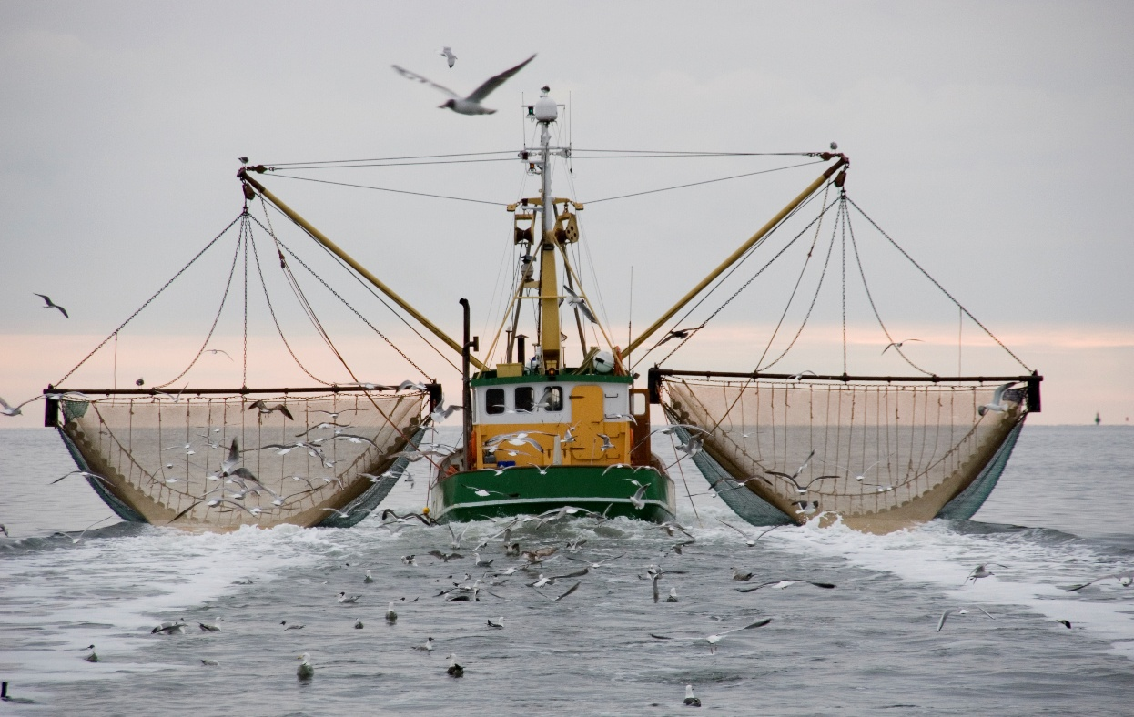
Deep Sea fishing
Large mechanized fishing vessel
Large net/ gears
On –board Refrigeration facilities
GPS system

Slide 30
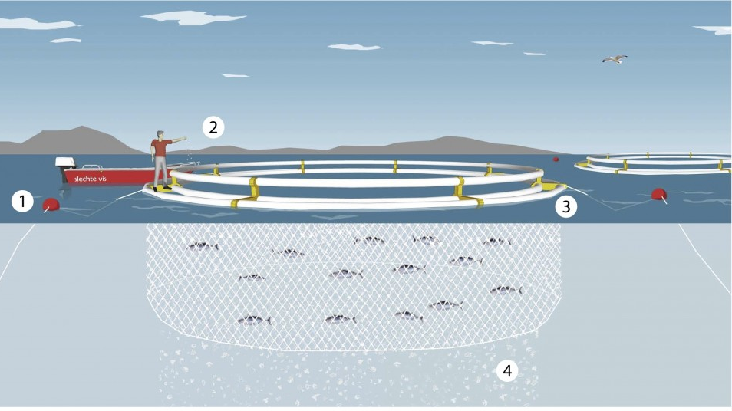
Open sea cage farming
Floating cage in open sea
Hatchery produced seedlings in cage
Fishes are fed by fishermen+ patrolling
Central Marine fishery institute provide skills to fishermen

Slide 31
Comparison marine and inland fishing
Growth of inland fishing faster than marine fishing
After the year of 2000 – production under inland fishing is more than marine

Slide 32
Inland fishing
Rivers, lakes, canals, deltas, backwaters, lagoons, estuaries

Slide 33
Largest producer of Inland fishing
West Bengal
Andhra Pradesh
Maharashtra
Gujarat
Kerala

Slide 34
Largest producer of Inland fishing
WB : Ganga delta, large demand
GJ: low local demand, 97% export/ other states
KR: lakes and lagoons -85% of produce is processed – intensively fished area
AP: fishing cooperatives – supply to WB

Slide 35
Blue Revolution
Started during 1970s – 5th FYP
Govt. set up Fish farmers development Agency
Later on Brackish water fish farmers development agency was set up
Objective:
Adoption of new technique of fish breeding, fish rearing, fish marketing and fish export
It led to increase in production of Shrimp – Nellor of AP – Shrimp capital of India

Slide 36
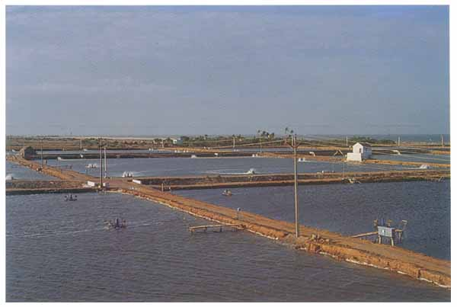
Brackish water aqua-culture
Carp culture introduction in 1980s
Artificial brackish water ponds – carp culture
AP, PN, HN, MH
AP: >73% of carp production (shrimp, prawn)

Slide 37
Brackish water aqua-culture: Issues
See-page from the brackish water ponds
Soil salinity and ground water salinity of surrounding regions

Slide 38
Potential in fishing sector
Breeding of High value fin-fish and shell-fish
Ornamental fish breeding
Organic aqua-farming
Upgradation of technology in cold water fish species
Development of water-recirculating units
Development of technology for inland saline areas

Slide 39
Fishing
mechanization
Bio-tech
sustainable
Germ-plasm
Modern trawlers
Eco-friendly techniques

Slide 40
Modernization of fishing sector
New generation
Trawlers and gears
Trade
Hygiene and quality control
Finance to fishing community
Information
awareness
Processing-packaging-marketing
Storage facilities

